Slide 1
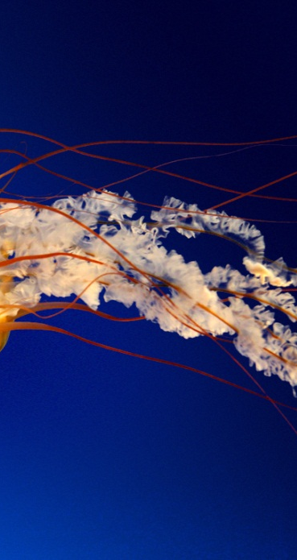
What is this object?
Hint: It can really sting.

Slide 2
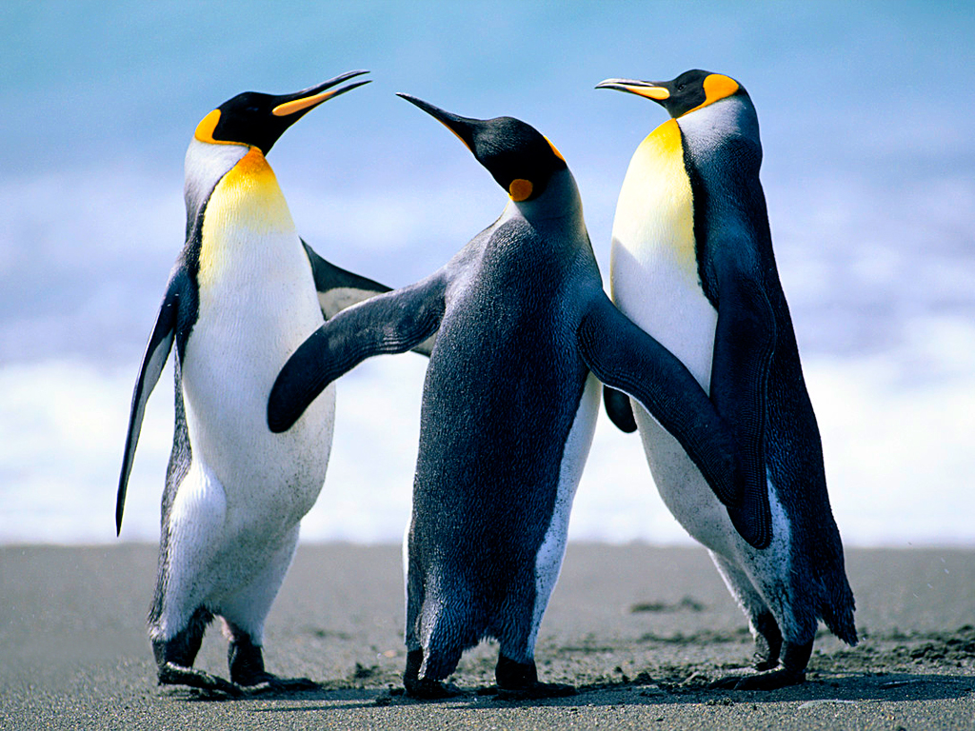
What are these three objects?
Hint: Mr. Popper had plenty of these.

Slide 3
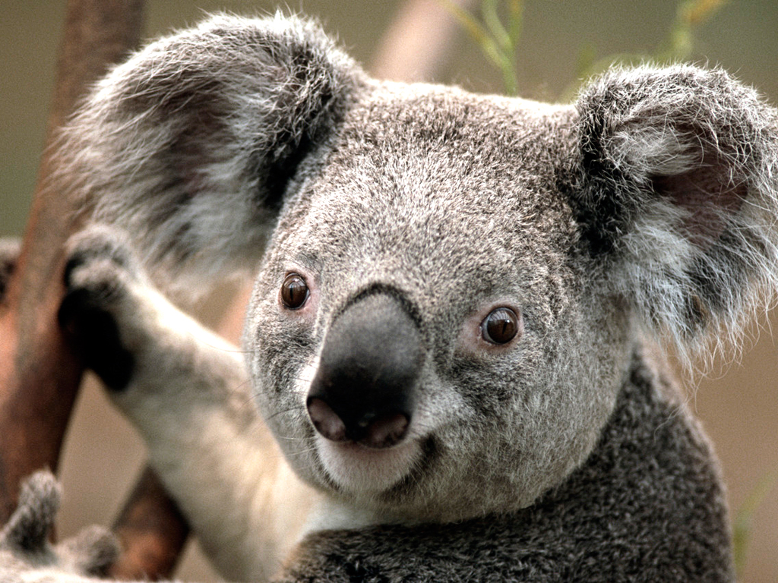
What is this object?
Hint: If we gave you a hint, it would give it away!

Slide 4
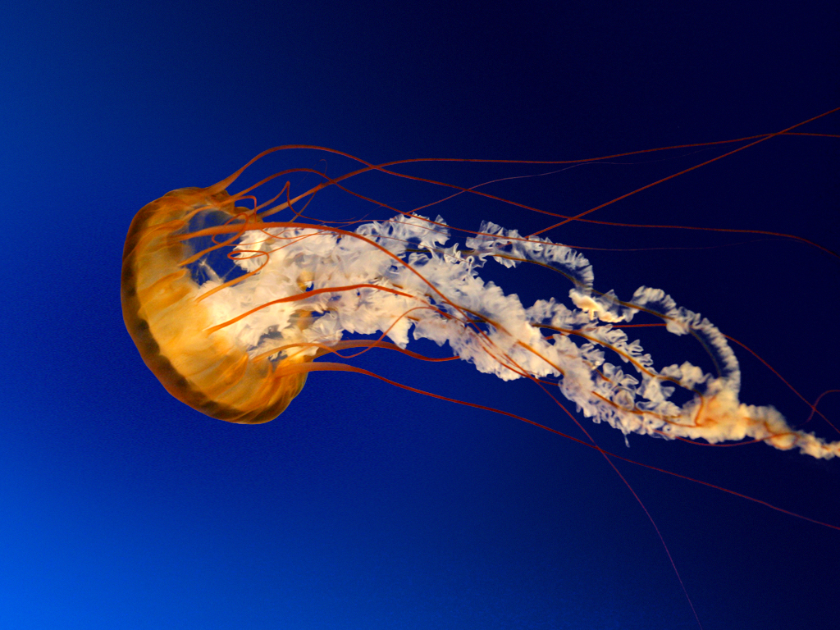
Slide 1 Answer
Jellyfish

Slide 5
Slide 2 Answer
Penguin trio

Slide 6
Slide 3 Answer
Koala

Slide 7
Inconsistencies
Iran boasts it has downed a US drone. Iranian governmental officials presented pictures that included a still photo of a craft. The craft in the picture did not show any signs of crash or damages. The story reached the front page of Iranian newspapers.

Slide 8
Inconsistencies
The store will honor all competitor coupons without exception. Coupons under 50% off the purchase price will be accepted. Coupons valued at more than the balance of the purchase will not result in cash refunds. Coupons that include BOGO will only be honored based on quantities in stock. Our wish is to have satisfied customers, who keep coming back.

Slide 9
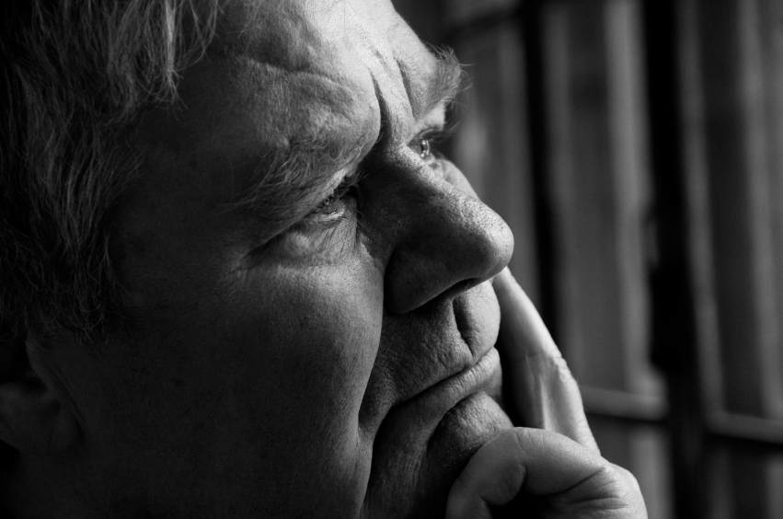
“What we know is shaped by the act of knowing.” - Thinking Skills for Professionals by Bryan Greetham

Slide 10
Pulling it all together
Retailers realize the economy is still recovering, and have been pulling out the stops. A team of retailers on South Congress, a 1 mile run of eclectic homebred businesses located in Austin, pulled together this past season to tackle the problem in a unique way. They wanted to encourage local shoppers while promoting the holiday spirit and repeat business. You were on that team and part of the planning included a brainstorming session called “stop the Grinch from getting Christmas.”

